Slide 1



Replacing Login VSI with PowerShell?
Samuel Owens
https://www.teamas.co.uk
@shammyowens
https://www.linkedin.com/in/shammyowens/

Slide 2

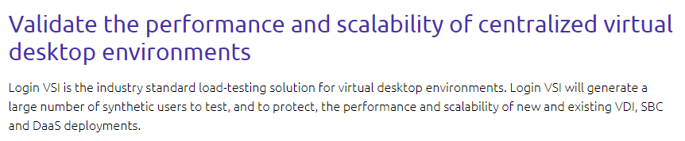
Introduction

Slide 3
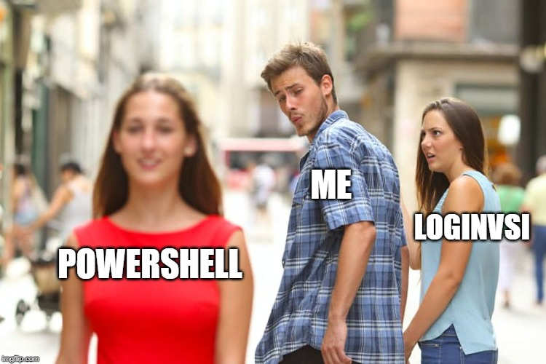
But why not just use Login VSI?
Licence renewal problem
Application performance metrics need

Slide 4
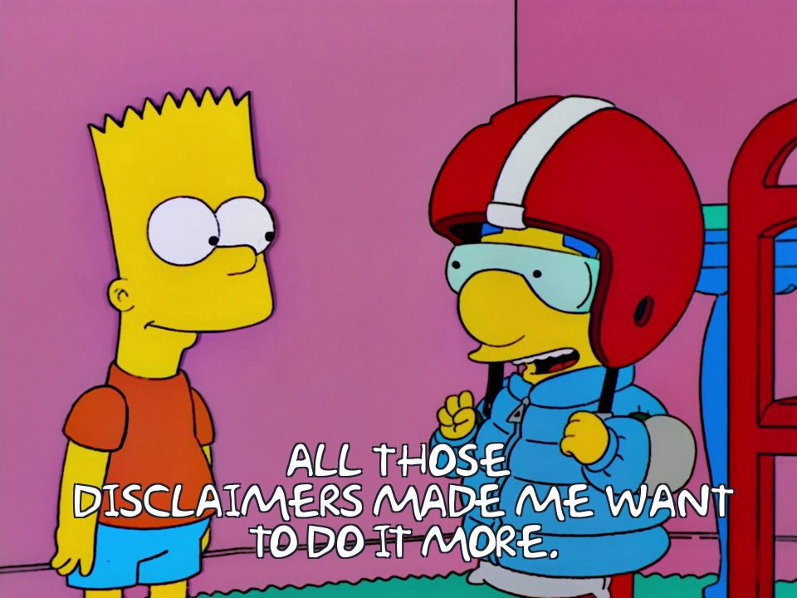
Disclaimers
LoginVSI is an excellent product, this presentation is purely to show what is possible with PowerShell only.
Use any of the examples at your own risk, test them in non-prod environment first.
I am not a developer, I know my way around PowerShell, but I know my limitations!

Slide 5
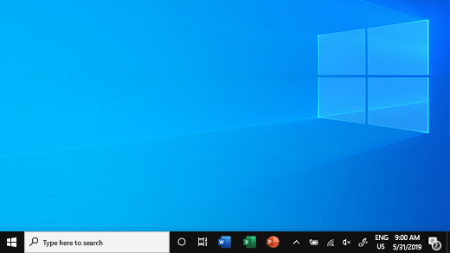


Architecture
Citrix VDAs
Workload Script
StoreFront
Prepare
ICA traffic
File Share
Control Script
Launcher VM

Slide 6

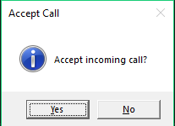
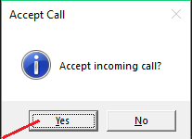
Workload Challenges to match Login VSI
Clicking mouse
Moving cursor
Switching window focus
Getting window information
Typing text in a realistic way
Handling errors
How to determine a step is successful?
Timing each step

Slide 7
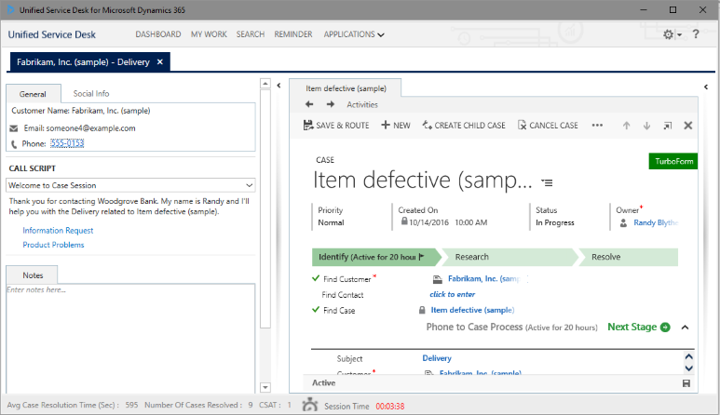
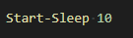
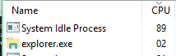
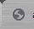
When has a step finished?
Start-Sleep
Check-CPU
Check-Log
Trace-Colour

Slide 8
Workload Script Preview
==INITIALISE==
Open Chrome
Browse to Extensions
Close Chrome
==MAIN TEST==
Open BBC.COM in Chrome
Go to BBC News
Go to BBC Sport
Open Notepad
Type some text
Switch focus back to Chrome
Loop
==========

Slide 9

Demo?

Slide 10
See workload demo on youtube https://youtu.be/c3H_ohaawik

Slide 11
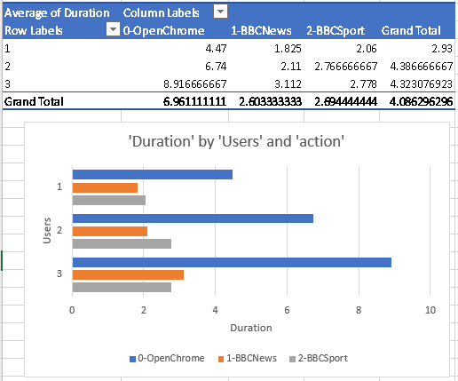
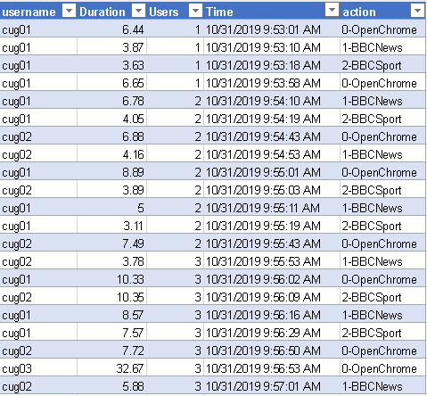
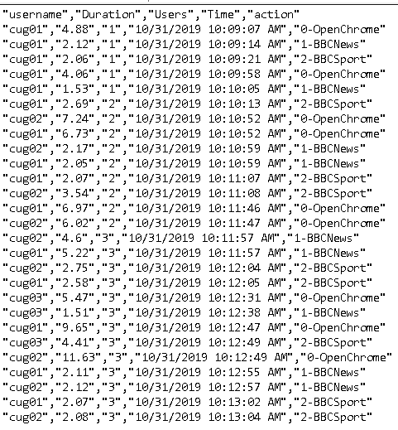
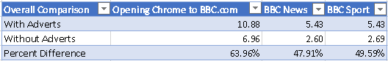
Output (Application)

Slide 12
Workload Functions
Notes:
So, let’s take a deeper look into some of the functions in the workload script. The next slides are not a deep dive into the code, but more an overview of the functions, the parameters and return result.

Slide 13
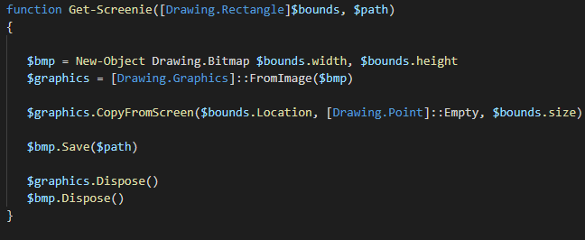

Get-Screenie
https://stackoverflow.com/questions/2969321/how-can-i-do-a-screen-capture-in-windows-powershell
This will take a screenshot and is useful to use to document how your script is going or to see why a test is failing.
Parameters
bounds - the resolution of the screenshot path - where to save the screenshot
Returns
nothing
Notes:
This function is used to take a screenshot of the session and it is really useful to trying to debug a failed load test. Maybe there was a pop-up in the way, or the window didn’t open maximised.
Interestingly, this was called get-screenshot, but recently Windows Defender AMSI would block this code. After troubleshooting for a while and contemplating disabling Windows Defender…..I found out that changing the name to Get-Screenie bypassed this detection…that certainly left me feeling like……

Slide 14
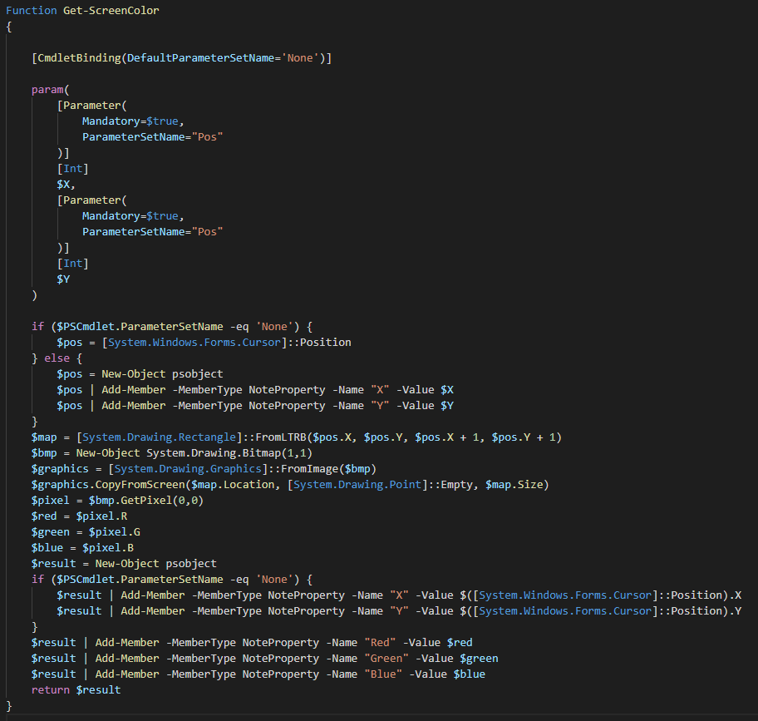
Get-ScreenColor
https://community.spiceworks.com/scripts/show/4263-get-screencolor
This will give you the RGB values for a particular pixel. If no X and Y provided, it returns current position
Parameters
X - x co-ordinates Y - y co-ordinates
Returns
Returns PScustomproperty with R,G,B colours and X,Y iif not specified
Notes:
This function is leveraged gets the colour of a pixel, you can specify which pixel, or if not, it will get the colour of the current position.

Slide 15
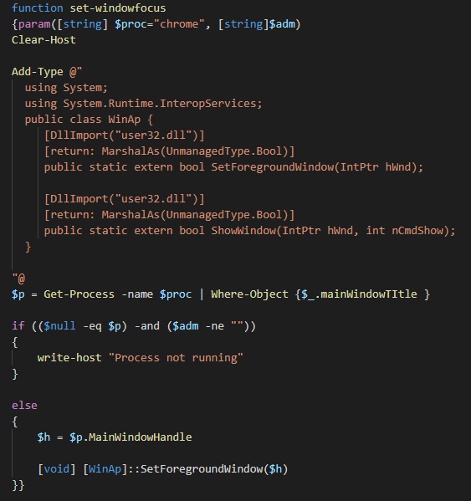
Set-WindowFocus
https://stackoverflow.com/questions/42566799/how-to-bring-focus-to-window-by-process-name/42567337#42567337
This will bring an application Window to the foreground.
Parameters
Proc - application name that you wish to bring into focus, defaults to Chrome
Returns
Nothing
Notes:
This function will bring an application window into focus. You just need to pass the process name into the function

Slide 16
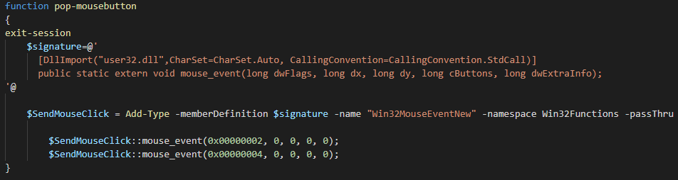
Pop-MouseButton
https://social.technet.microsoft.com/Forums/en-US/48f12259-213c-43a5-99fa-5814928b0145/mouse-click?forum=winserverpowershell
This will complete a single click of the left mouse button
Parameters
None
Returns
None
Notes:
This function does a simple click of the left mouse button.

Slide 17
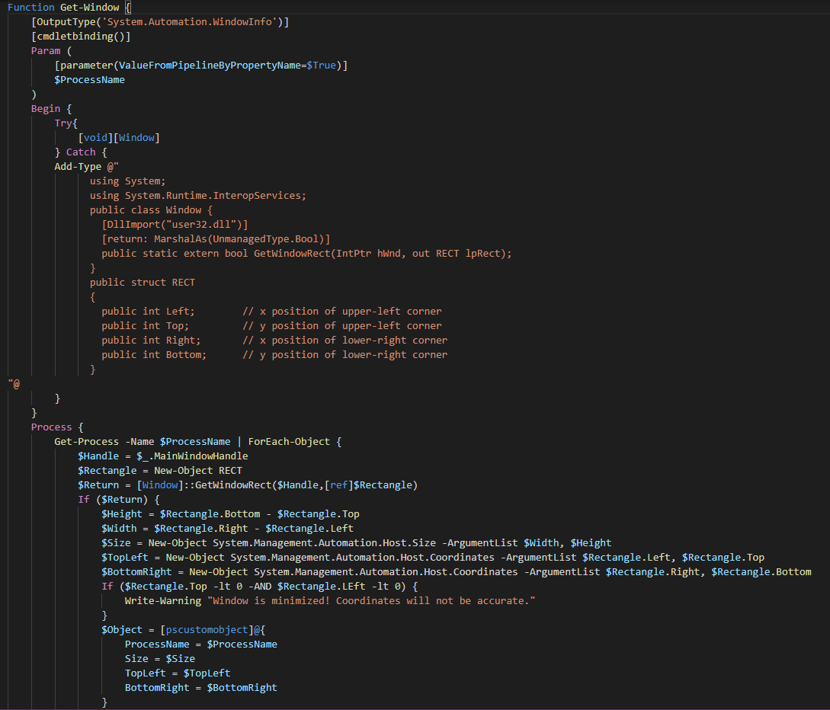
Get-Window
https://gallery.technet.microsoft.com/scriptcenter/Get-the-position-of-a-c91a5f1f
This will provide information on window position for an application.
Parameters
ProcessName - application of which you want the co-ordinates of
Returns
Returns windowinfo object which says the processname, its size and the position of topleft and bottomright on the screen.
Notes:
This is the function which will get the co-ordinates of a Window and was used to resolve the magically jumping accept call prompt!

Slide 18
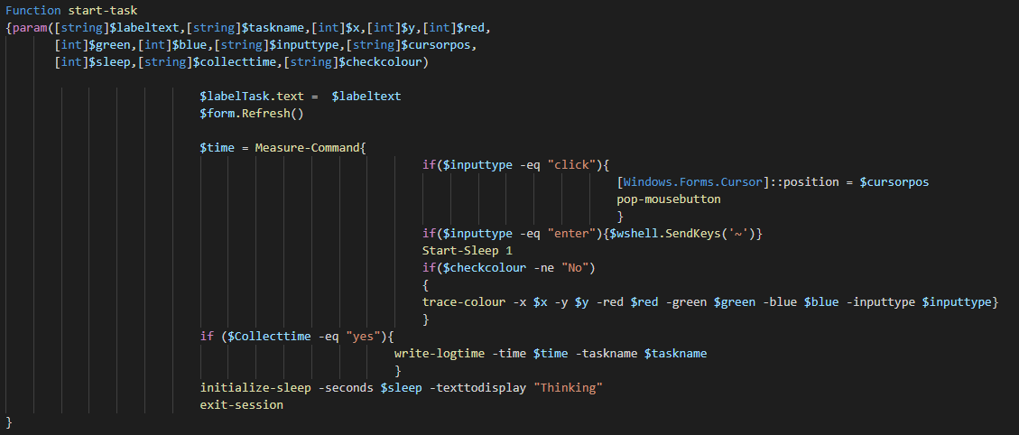
Start-Task
This function is the glue that brings others together
Parameters
labeltext – what shows in the feedback form taskname – what is written in timing log file inputtype – click or enter cursorpos – which co-ordinates to place the cursor prior to click -x -y -red -green –blue – where to look and what colour to see before proceeding sleep – how long to sleep after collecttime – saying yes will collect time taken into a CSV.
Returns
Nothing

Slide 19
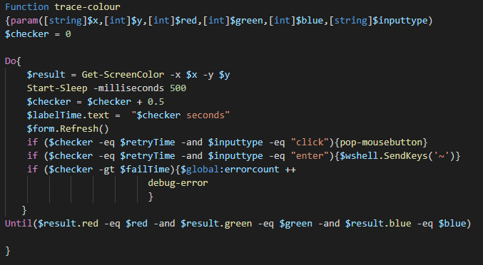
Trace-Colour
This function checks for a colour in a pixel continously. It will not move on until it has found this, or a certain time has passed
Parameters
inputtype – click or enter -x -y -red -green –blue – where to look and what colour to see before proceeding Returns
Nothing

Slide 20
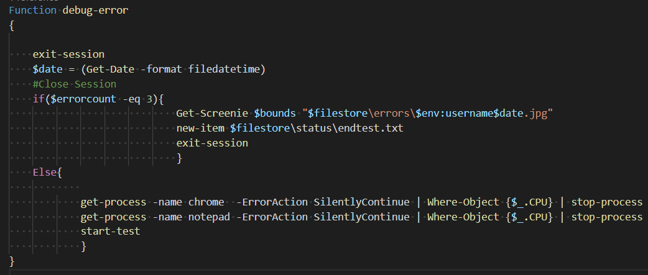
Debug-Error
This function is called when something hasn't gone to plan, it will try and retry an action or if it has taken place three times for a user, take a screenshot and end the test
Parameters
None
Returns
Nothing

Slide 21
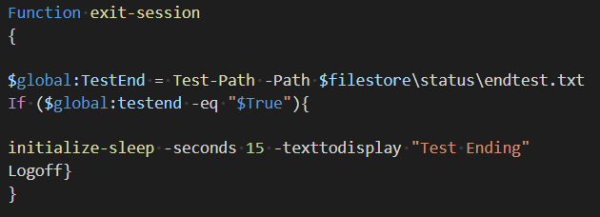
Exit-Session
This function is called when the test needs to end. It could contain steps to gracefully close applications prior to logging the user off.
Parameters
None
Returns
Nothing

Slide 22
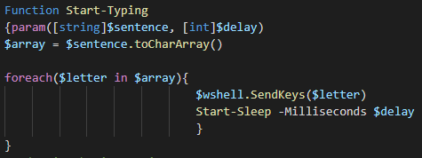
Start-Typing
This function types a sentence with delay between each character to mimic normal typing.
Parameters
sentence – what to type delay – delay in milliseconds between each character stroke
Returns
Nothing

Slide 23
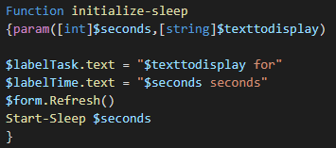
Initialize-Sleep
This function sleeps the scripts for a period of time whilst providing feedback to anyone watching
Parameters
seconds – what shows in the feedback form texttodisplay – What is shown on the feedback form
Returns
Nothing

Slide 24
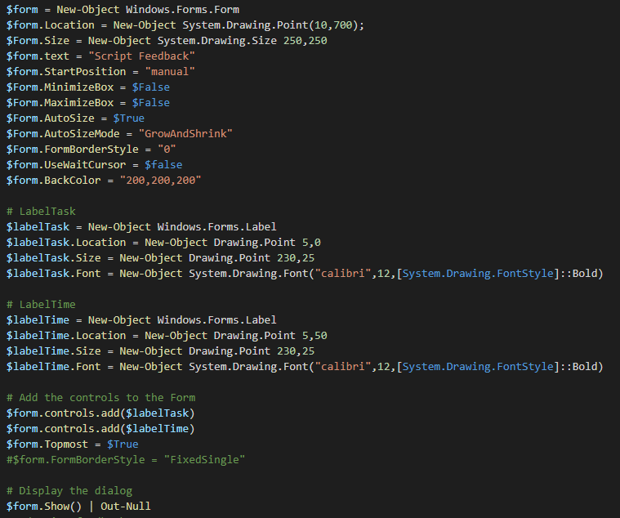
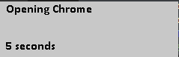
Feedback Form
Not a function, but an important part of the script. It is used to provide some visual feedback and looks as below.

Slide 25
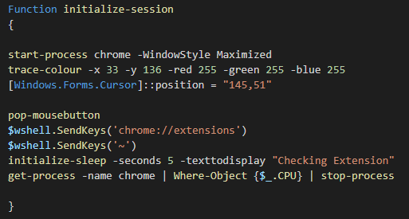
Initialize-Session
This function runs once per workload and is used to setup the session, this could be to set regkeys etc.
Parameters
None
Returns
Nothing

Slide 26
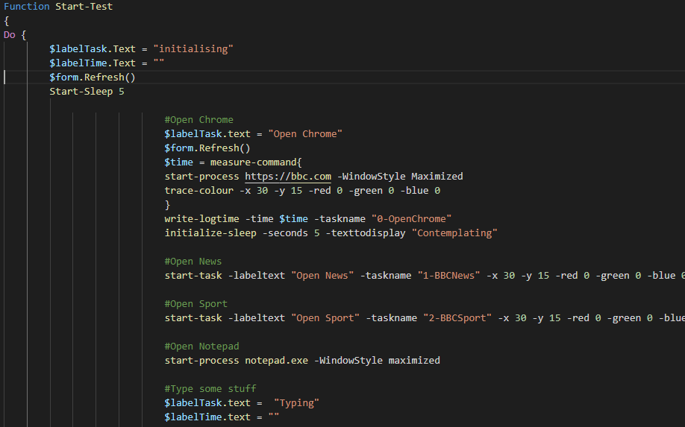
Start-Test
This function is the main workload and will constantly loop until test has been ended
Parameters
None
Returns
Nothing

Slide 27
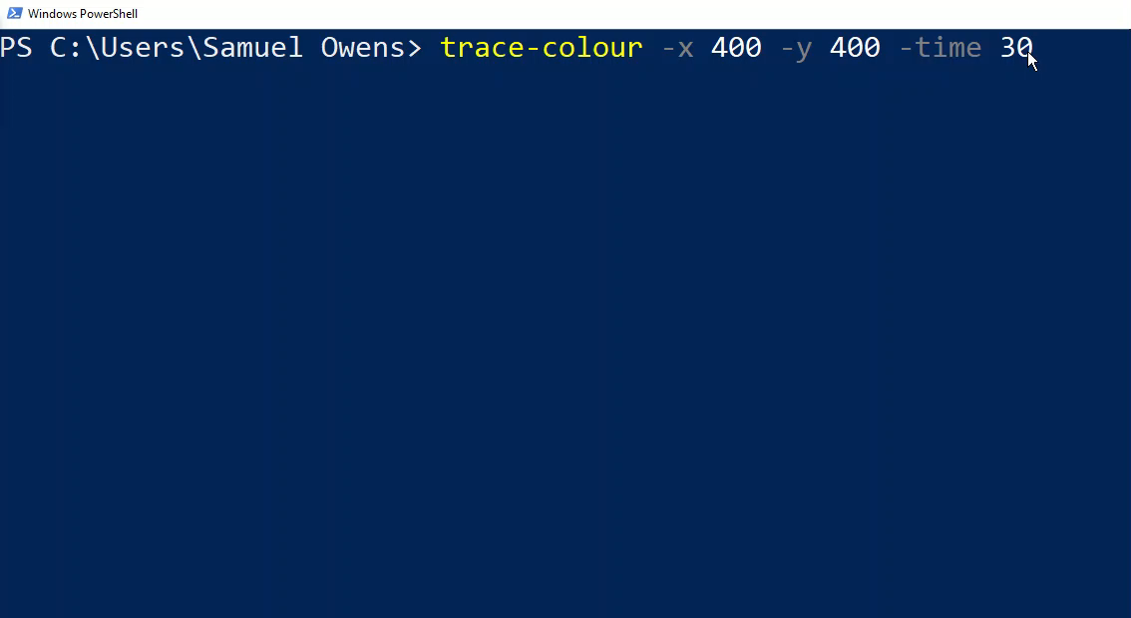
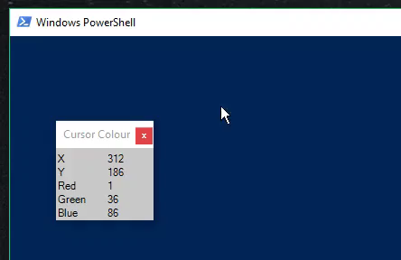
Workload Script Tools
ColourPicker.ps1 is a GUI to provide RGB values on cursor script
ColourLoop.ps1 is PowerShell script used to provide RGB values in a loop. Useful for tracking a pixel colour whilst page is loading.

Slide 28
Control Script

Slide 29
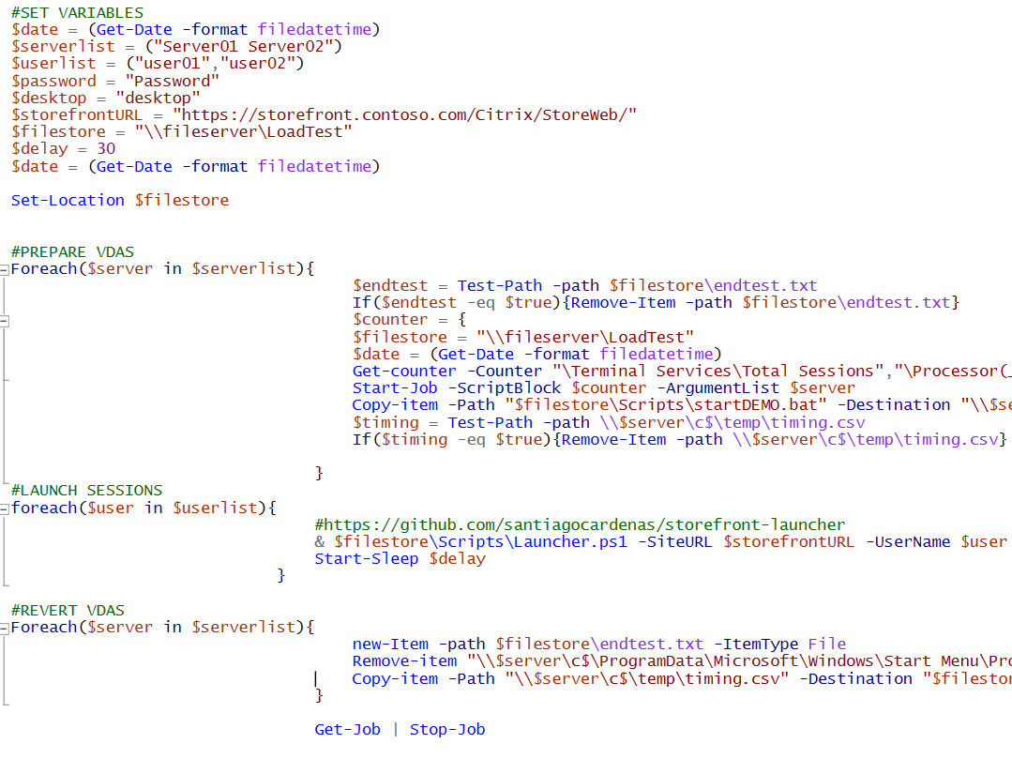
Control Script Version 1
Console Based
Run per Launcher
Console Based
Run once per launcher
Notes:
The Control Script is used to Prepare and Launch the tests. It will also wind-down the tests after they have completed.

Slide 30
See control v1 demo on YouTube
https://youtu.be/5daZJBRz8dQ

Slide 31
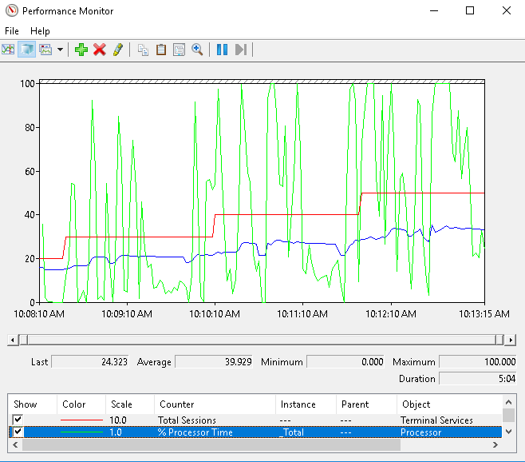
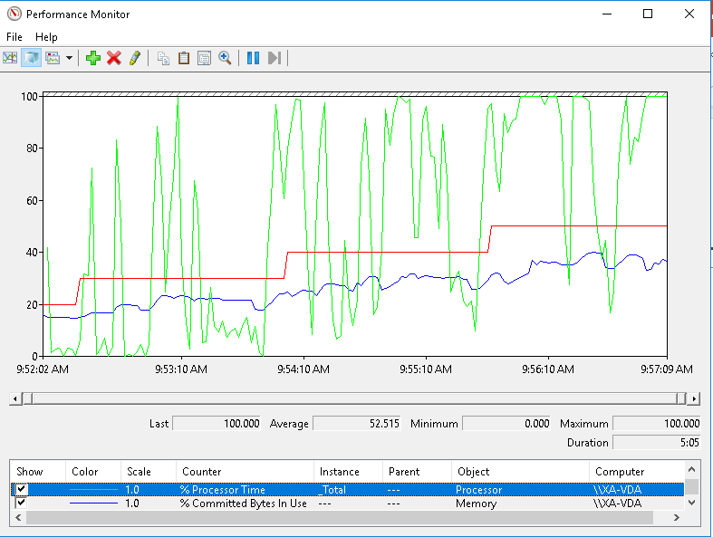
Output (Infrastructure)
No Adverts
With Adverts

Slide 32
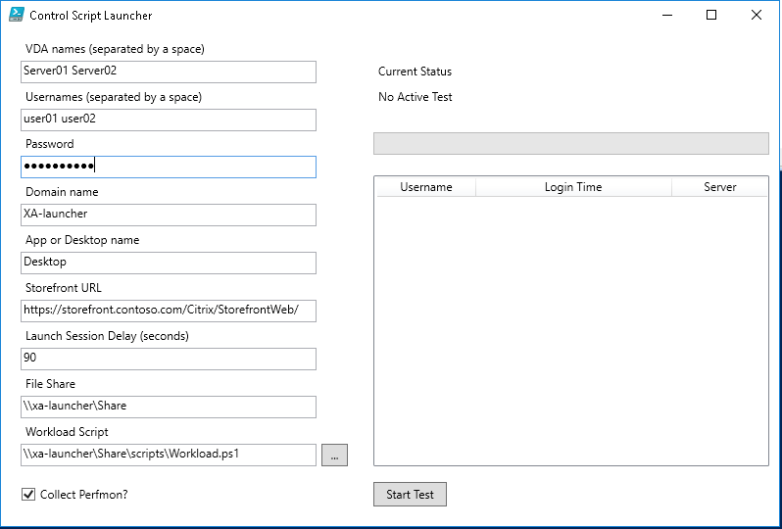
Control Script Version 2
Console Based
Run per Launcher
GUI Based
Uses runspaces
Provides feedback
Easier to stop test
Run once per launcher
Notes:
The Control Script is used to Prepare and Launch the tests. It will also wind-down the tests after they have completed.

Slide 33
See control v2 demo on YouTube.com
https://youtu.be/O75-CioVPW0

Slide 34
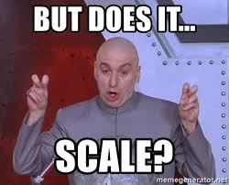

Slide 35

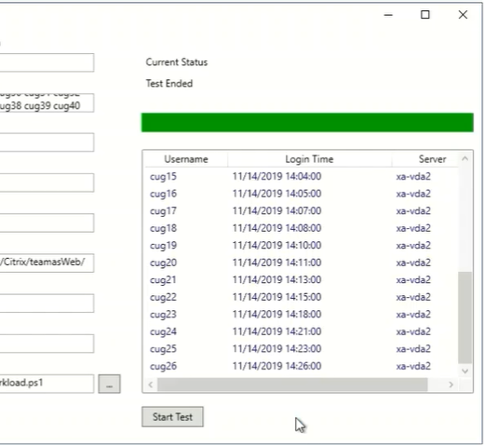
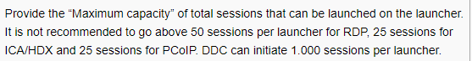
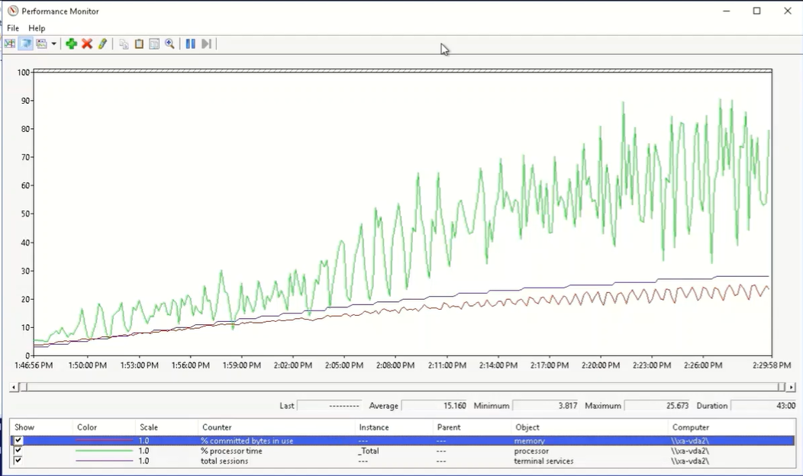
Scale
26 Users from a single launcher
40 user test unsuccessful
Matches LoginVSI recommendation of 25
https://www.loginvsi.com/documentation/index.php?title=Login_VSI_Configuration

Slide 36
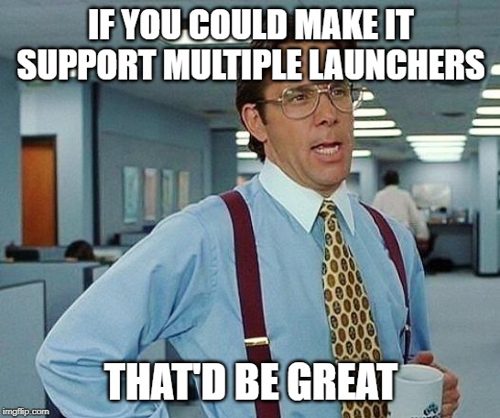

Slide 37
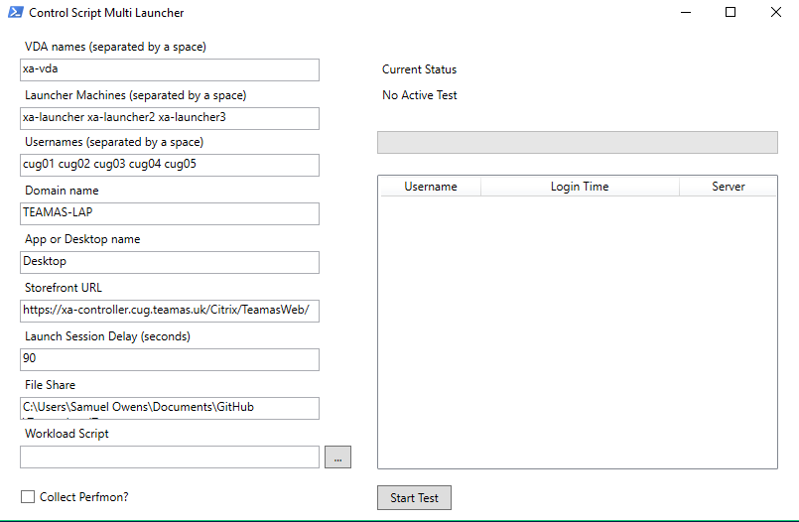
Control Script Version 3
GUI Based
Uses runspaces
Provides feedback
Easier to stop test
Leverages multiple launchers
Notes:
The Control Script is used to Prepare and Launch the tests. It will also wind-down the tests after they have completed.

Slide 38
Architecture
Citrix VDAs
Workload Script
Prepare
StoreFront
ICA traffic
File Share
Launcher VM
Controller
LaunchServer Script
Control Script

Slide 39
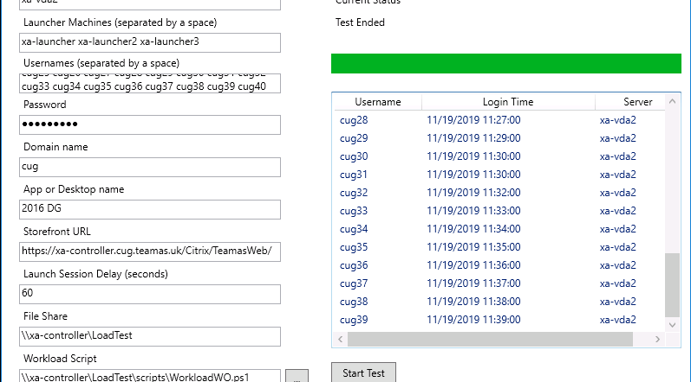
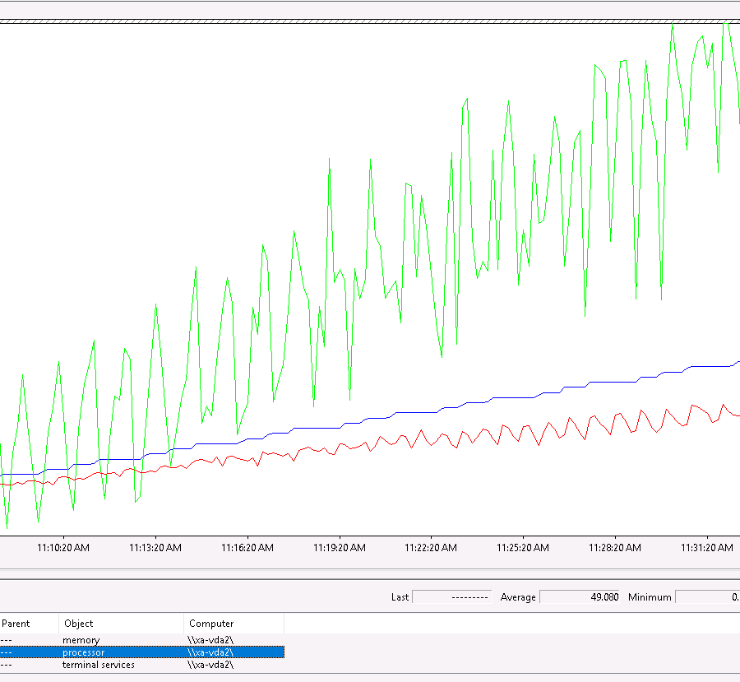
Multi Launcher Scale
40 sessions from a three launchers
Need some more Azure Credit to see how far this can go ☺

Slide 40
See control v3 demo on YouTube
https://youtu.be/9DdjbUW-kr4

Slide 41
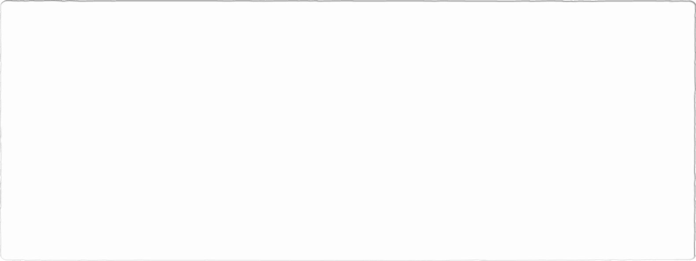
How could it be improved?
Workload
Tidying up functions
Deal with DPI scaling
Control
More/Better error handling
More/Better error handling
Workload Script recorder
Feedback in XAML rather than WinForms
Tidying up runspaces
More user friendly input e.g. userXXX or AD style picker
Better timing to take session launch variations
Notes:
There are quite a few ways this tool could be improved.
DPI scaling is a massive pain, if I am running from a laptop, I need to ensure that window scaling is set to 100%
A script to record the workload rather than typing it out in PowerShell could be useful and using XAML to create a sexier feedback form would be good. I have used Stephen Owen’s set of blog posts to create powershell GUI’s in the past and I recommend this as a place to start if you are looking in this error.
From a control perspective, it is about data collection and installation.

Slide 42

Conclusion
Keep using Login VSI or a proper COTS load testing product
Hold your project teams to account (app testing or infrastructure testing)
Let people know about this tool, it could be useful to someone!
https://github.com/shammyowens/TeamasLoadTest

Slide 43
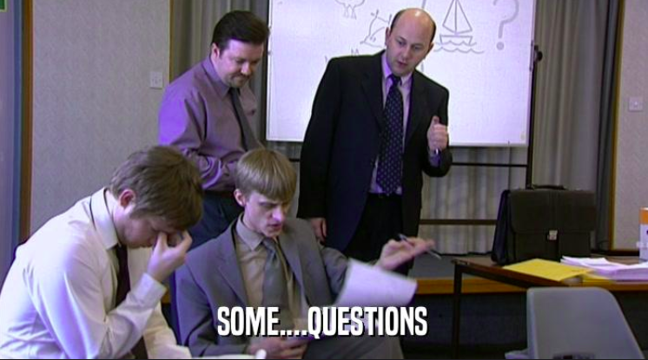
Thank you!
Samuel Owens
https://www.teamas.co.uk
@shammyowens
https://www.linkedin.com/in/shammyowens/

